Slide 1




Fungi fact
or
fungi fiction
@RowenaCHill

Slide 2
What are fungi?
@RowenaCHill

Slide 3
@RowenaCHill

Slide 4
They’re everywhere and interact with everything
Plants
Water
Animals
Permafrost
Soil
Rocks
Air
@RowenaCHill

Slide 5
They’re so diverse
@RowenaCHill

Slide 6

They’re so diverse
@RowenaCHill

Slide 7

They’re indispensable to us
Biofuels
Leather and cotton processing
Soy sauce and miso
Alcohol
Dairy
Manufacturing and industry
Edible fungi
Food
Plastics and biomaterials
Paper manufacturing
Breadmaking
Meat substitutes
Washing detergents
Statins
Medicine
Bioremediation
Psychedelics
Immunosuppressants
Environmental management
Antibiotics
Agricultural biocontrol
@RowenaCHill

Slide 8
Let’s play…
Fungi fact
or
fungi fiction
@RowenaCHill

Slide 9
The world’s first mass-produced antibiotic was discovered from a fungus
@RowenaCHill

Slide 10
The world’s first mass-produced antibiotic was discovered from a fungus
TRUE!
@RowenaCHill

Slide 11
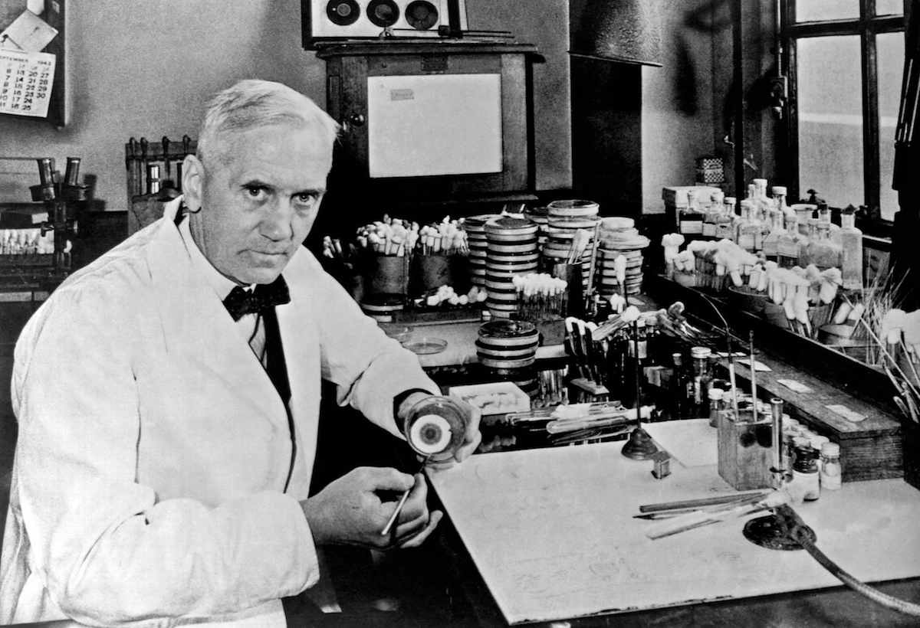
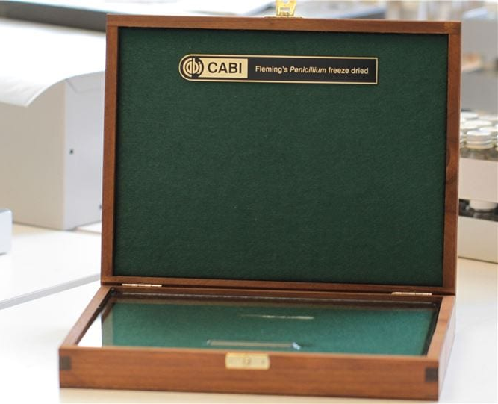
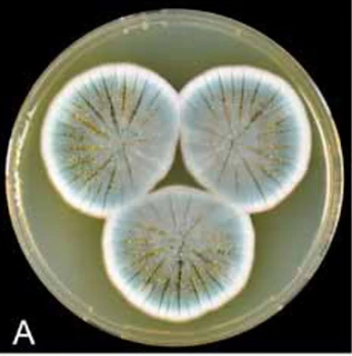
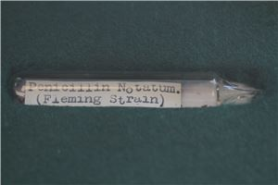
Penicillin
Although…
Penicillium
Houbraken et al. 2011
@RowenaCHill

Slide 12
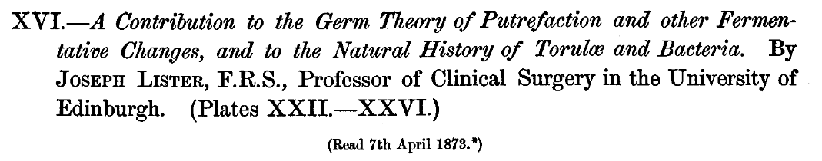
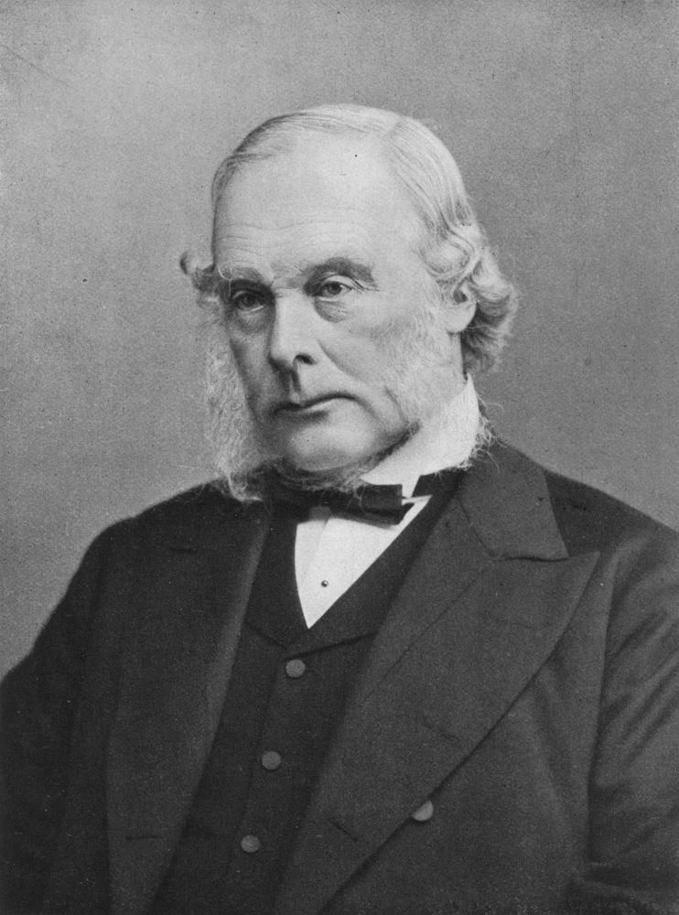
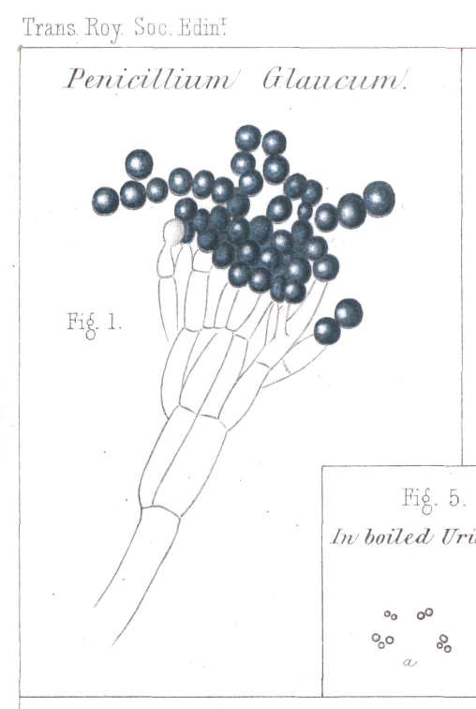
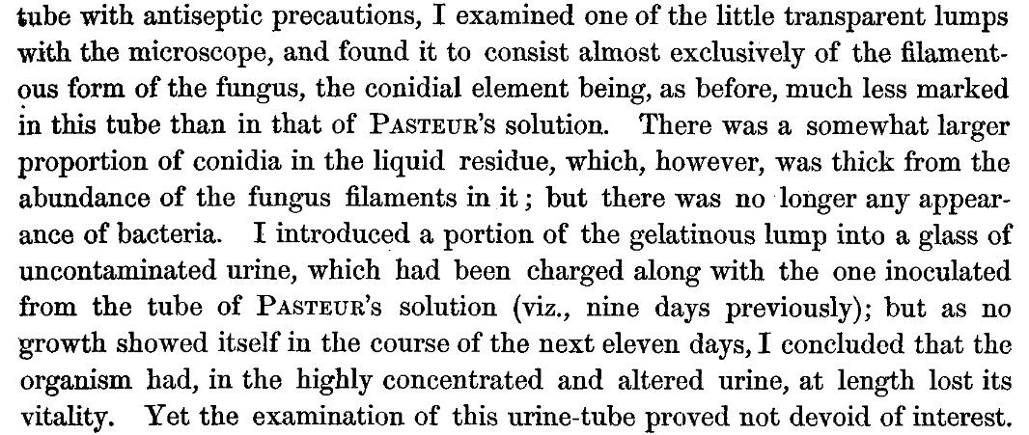
@RowenaCHill

Slide 13
Psychedelics are a promising treatment for mental health conditions
@RowenaCHill

Slide 14
Psychedelics are a promising treatment for mental health conditions
Steady on…
@RowenaCHill

Slide 15
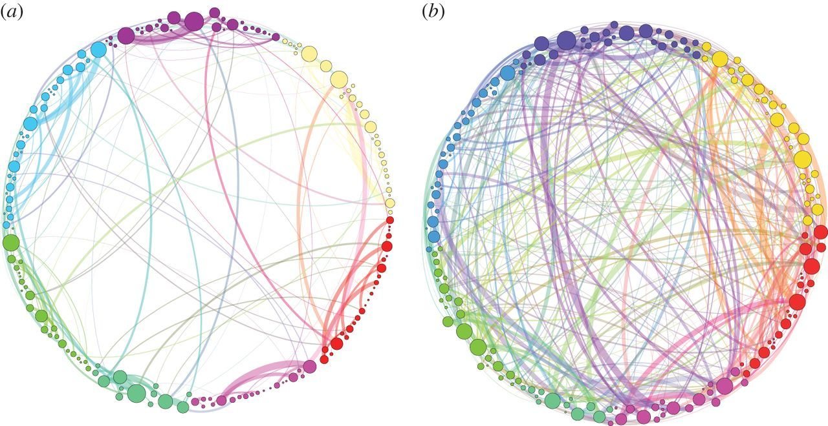
Petri et al. 2014
@RowenaCHill

Slide 16
Petri et al. 2014
@RowenaCHill

Slide 17
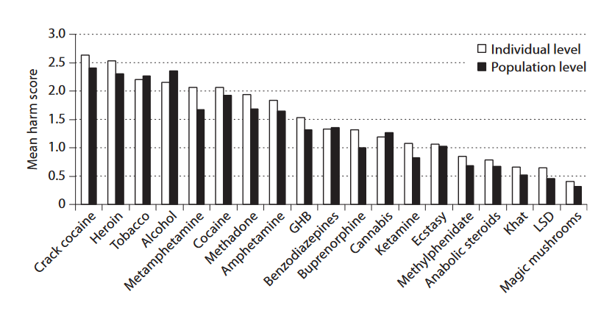
van Amsterdam et al. 2010
@RowenaCHill

Slide 18

van Amsterdam et al. 2010
@RowenaCHill

Slide 19

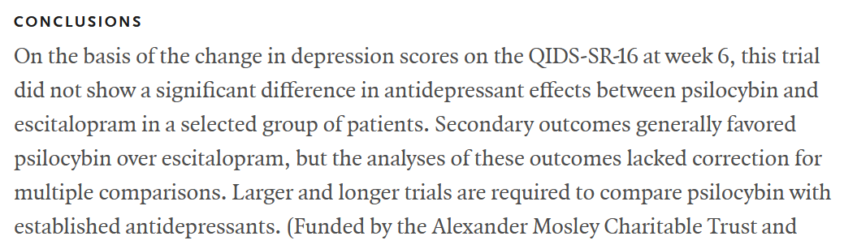
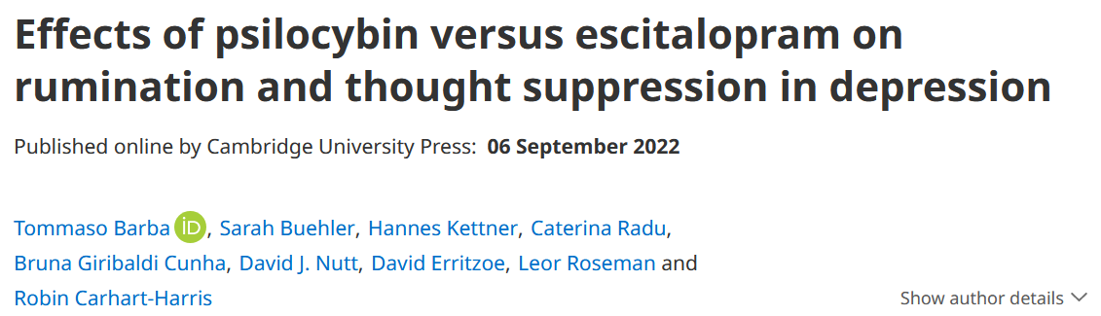
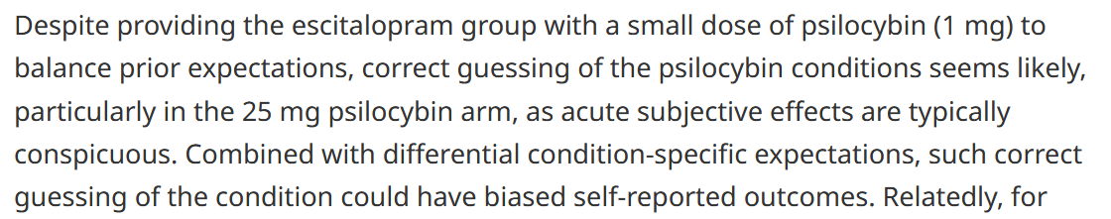
@RowenaCHill

Slide 20

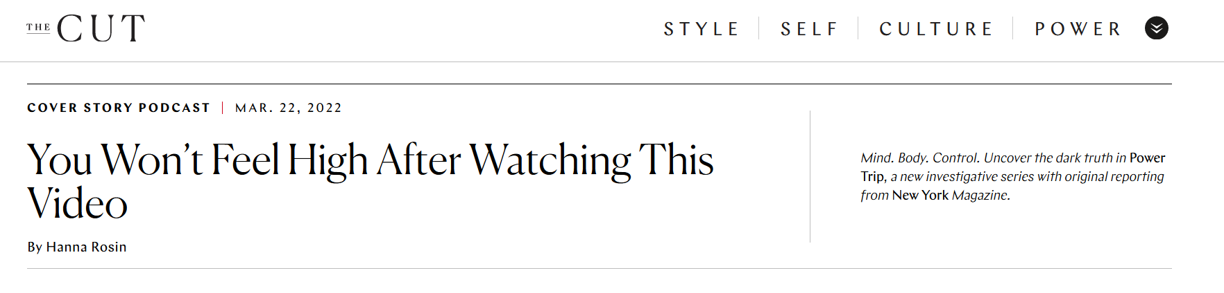
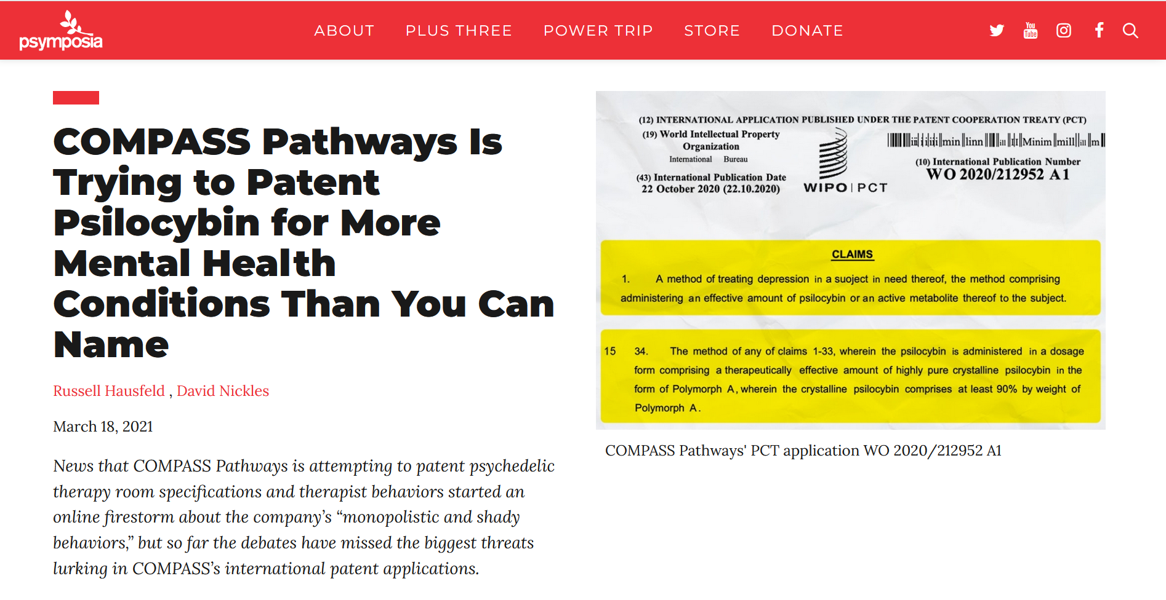

@RowenaCHill

Slide 21
Trees communicate via an underground network of fungi, the ‘wood wide web’
@RowenaCHill

Slide 22
Trees communicate via an underground network of fungi, the ‘wood wide web’
Not that we know of…
@RowenaCHill

Slide 23
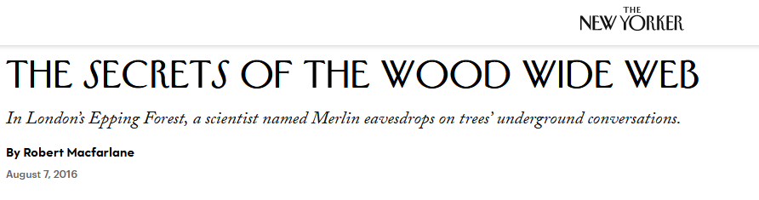
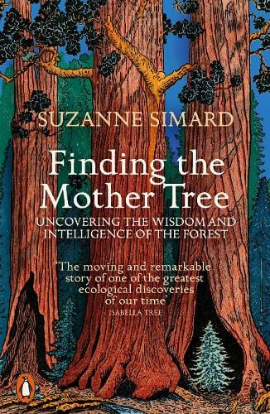
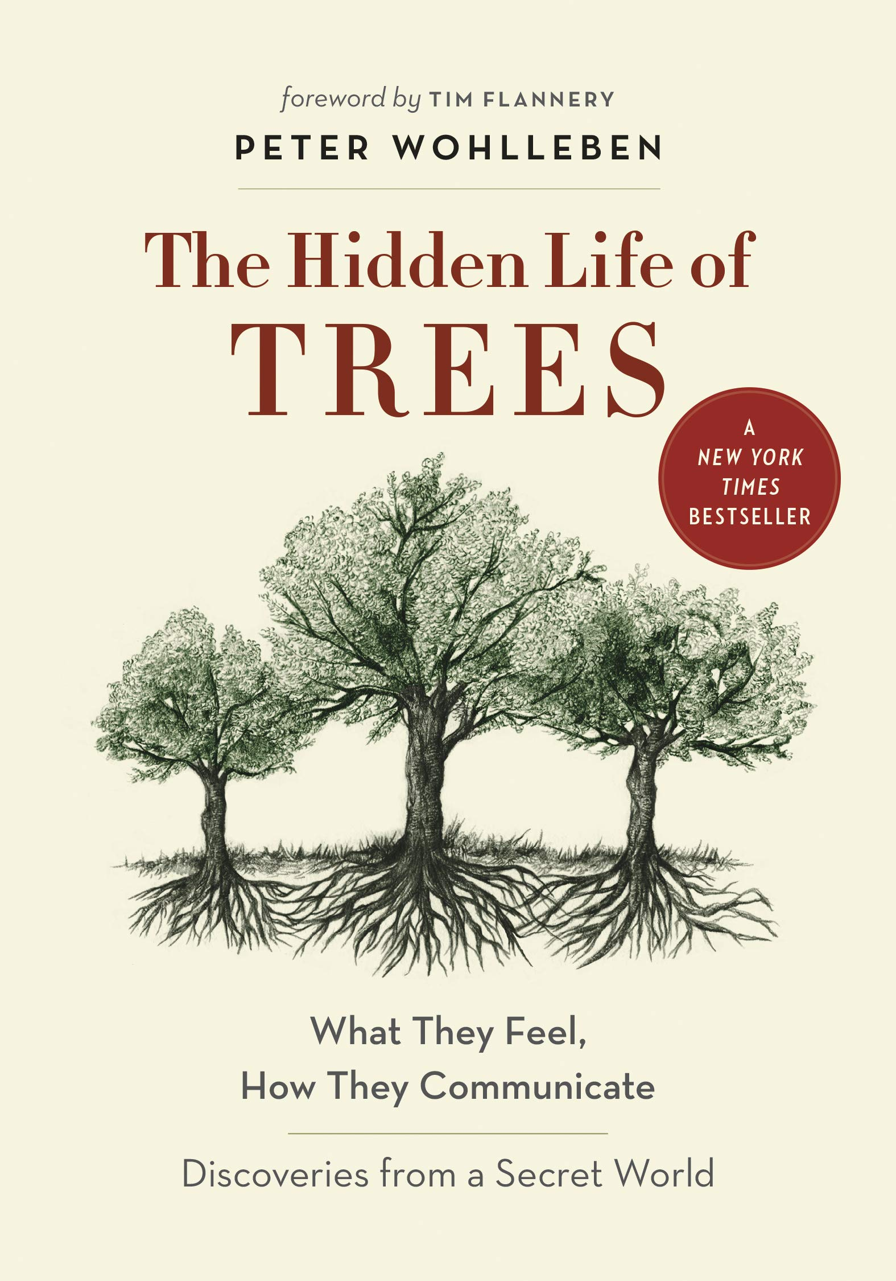
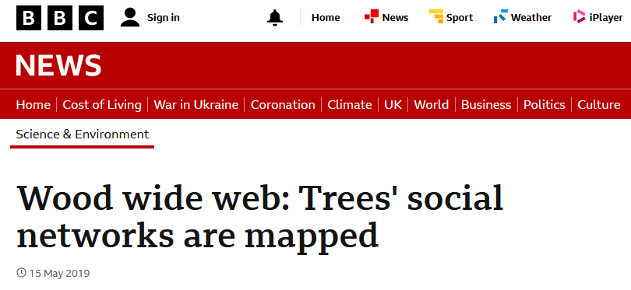
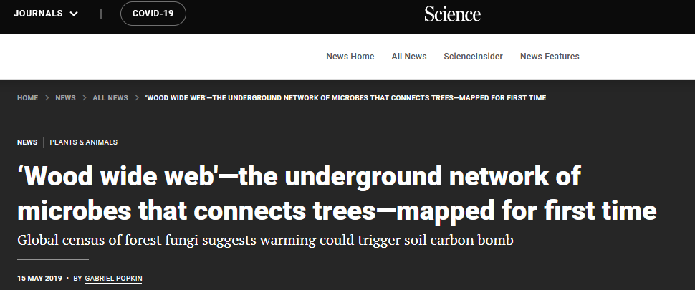
@RowenaCHill

Slide 24
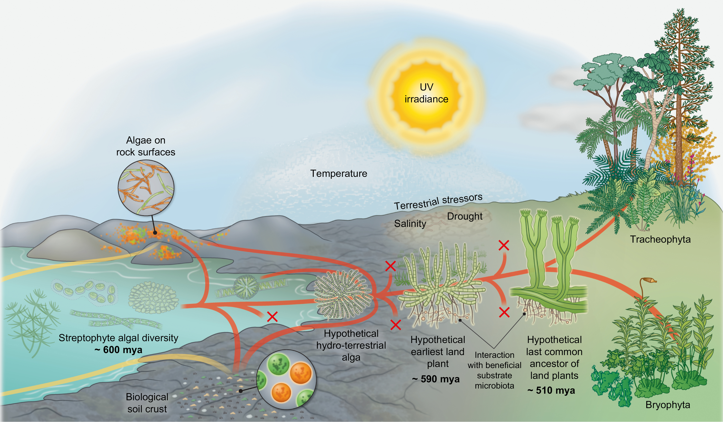

@RowenaCHill
Fürst-Jansen et al. (2020)

Slide 25
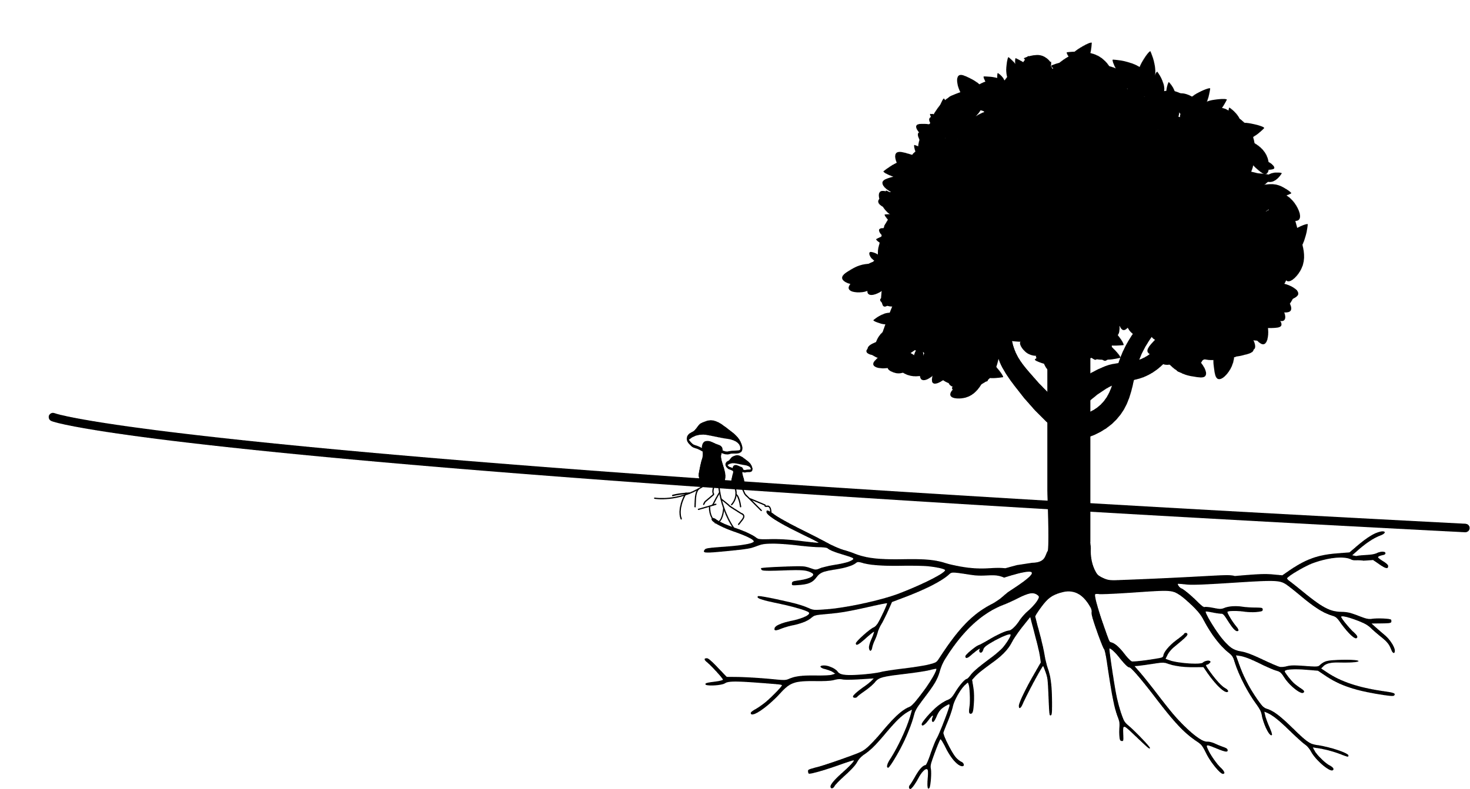
“…most of the stored carbon in boreal forested islands in Sweden is in fact derived from mycorrhizal mycelium rather than from plant litter.”
Clemmensen et al. (2013)
@RowenaCHill

Slide 26
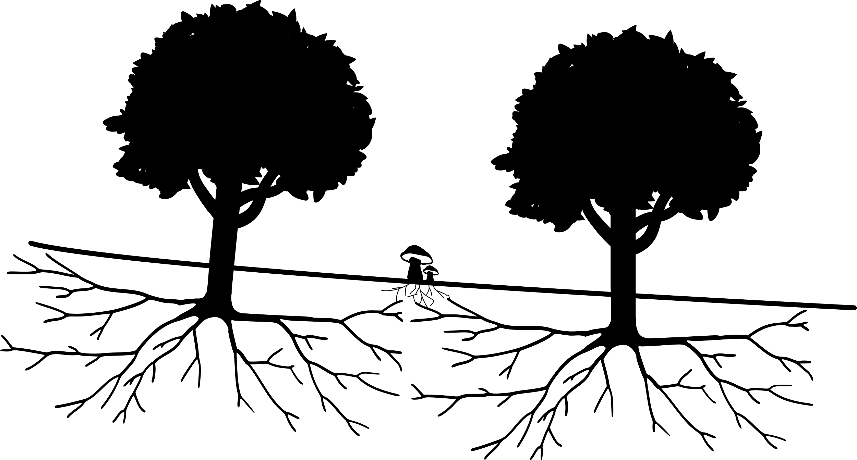
???
“The claim that mature trees preferentially send resources and defence signals to offspring through [mycorrhizal fungi] has no peer-reviewed, published evidence.”
Karst et al. 2023
@RowenaCHill

Slide 27
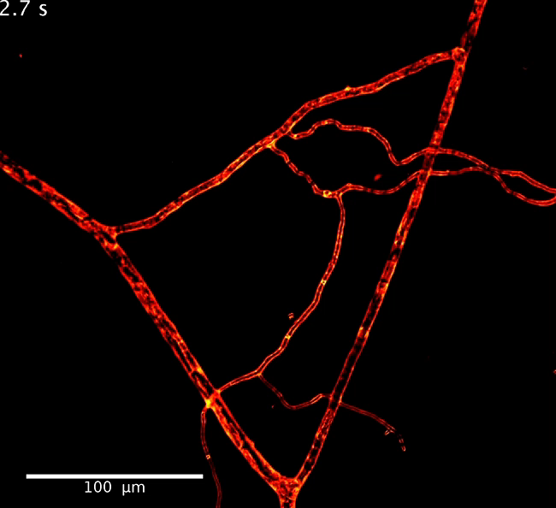
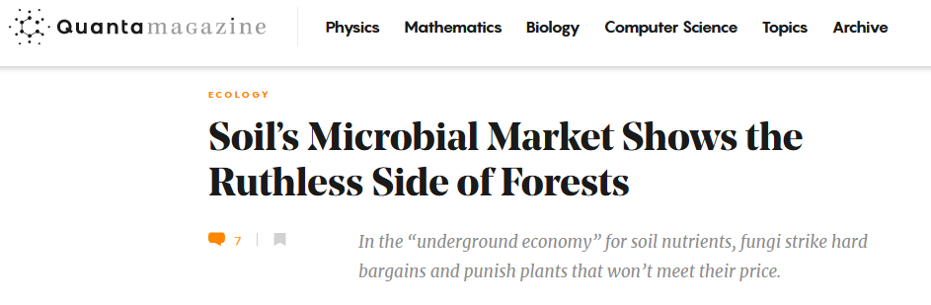
Whiteside et al. 2019
@RowenaCHill

Slide 28
TRUE!
???
@RowenaCHill

Slide 29
Some fungi can break down plastic
@RowenaCHill

Slide 30
Some fungi can break down plastic
TRUE!
@RowenaCHill

Slide 31

@RowenaCHill

Slide 32
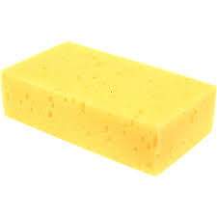

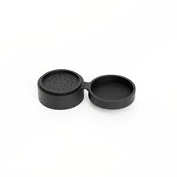

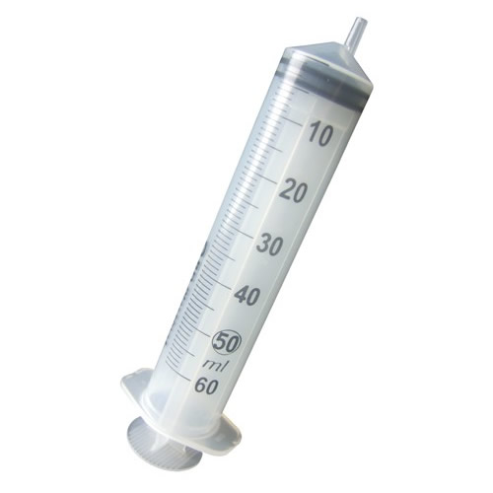

Russell et al. 2011
polypropylene
polyurethane
Samat et al. 2023
@RowenaCHill

Slide 33
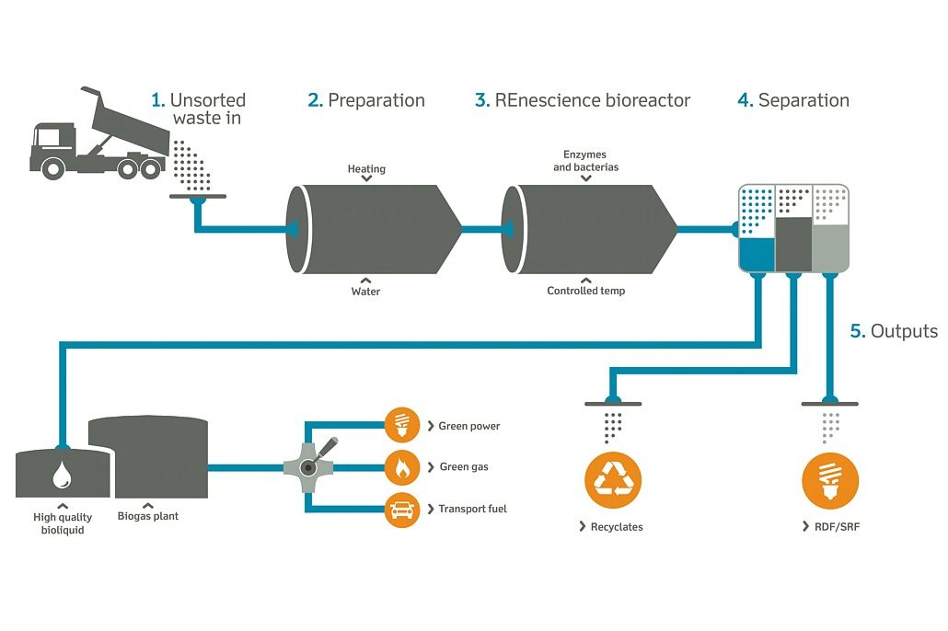

ONE DAY…
https://orsted.co.uk/energy-solutions/renescience
@RowenaCHill

Slide 34
The Salem Witch Trials were actually a result of fungi poisoning
@RowenaCHill

Slide 35
The Salem Witch Trials were actually a result of fungi poisoning
BUSTED
@RowenaCHill

Slide 36
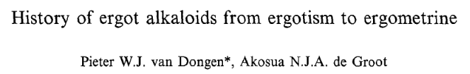
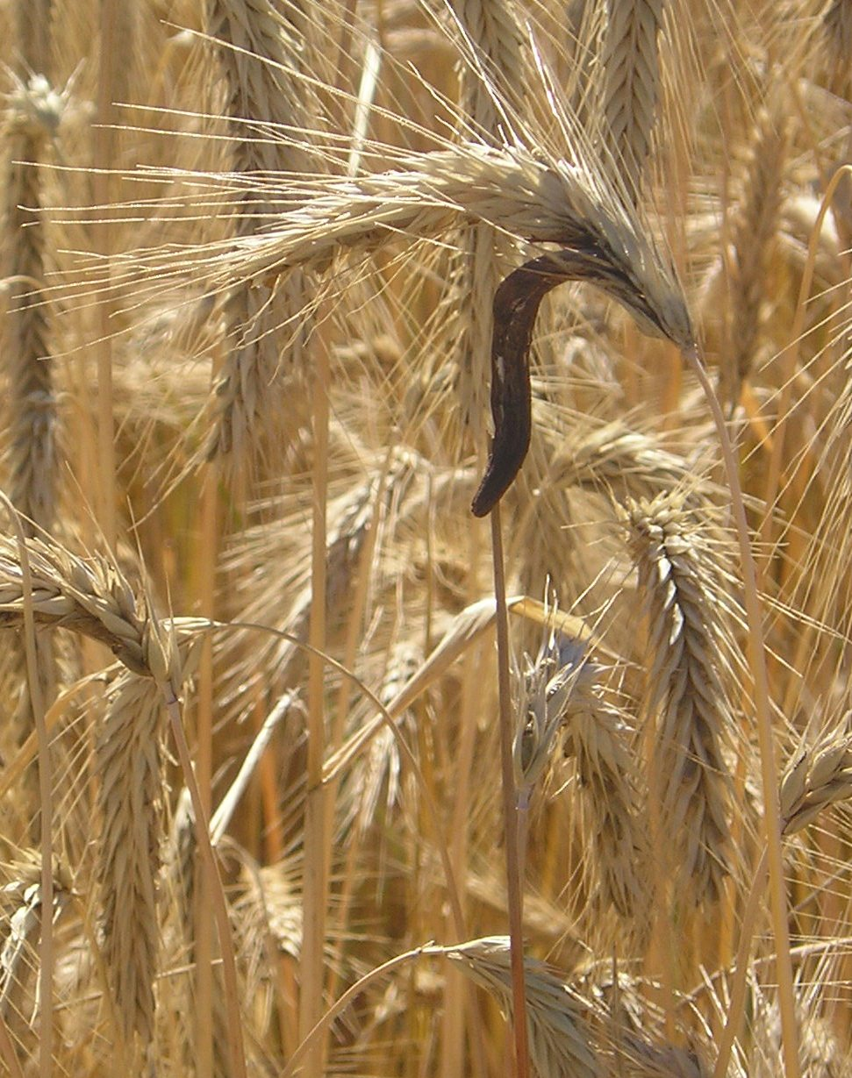
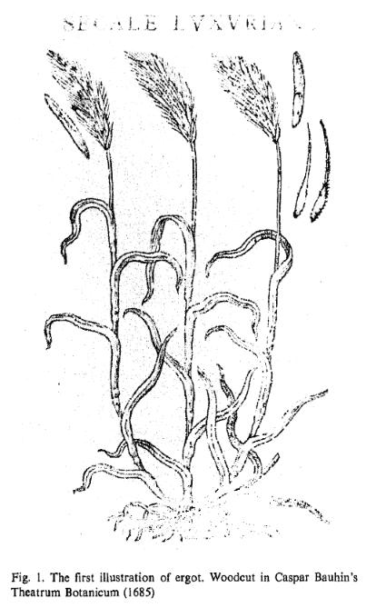
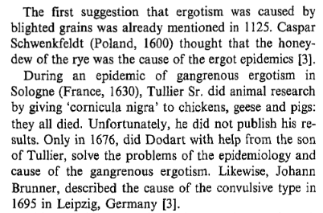
Claviceps purpurea
@RowenaCHill

Slide 37
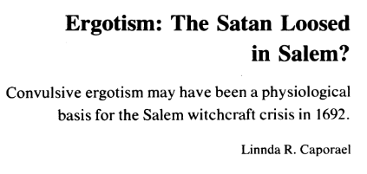
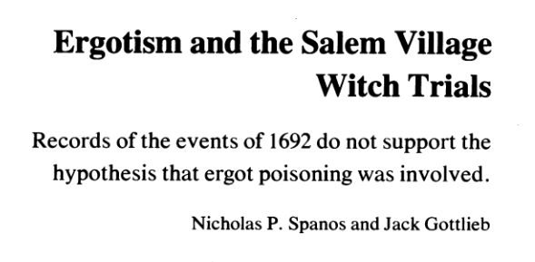
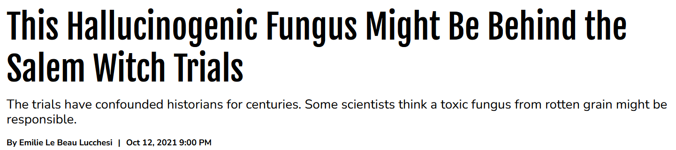
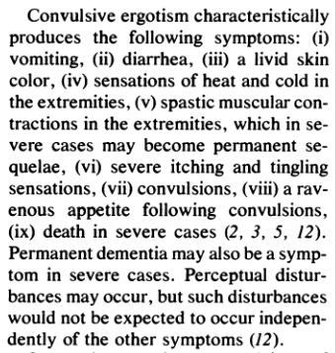
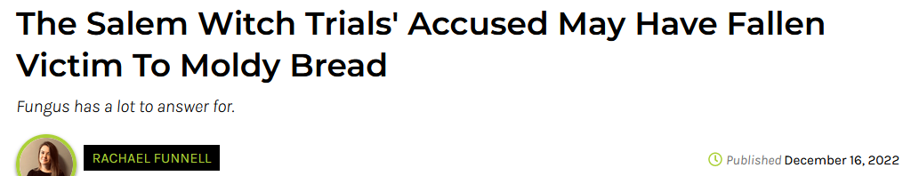
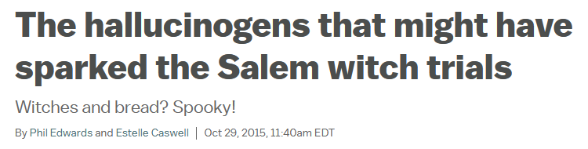
@RowenaCHill

Slide 38




The symptoms just don’t stack up
@RowenaCHill

Slide 39

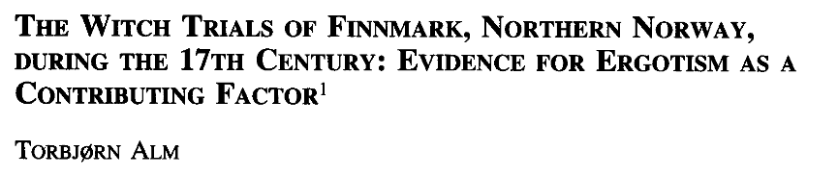
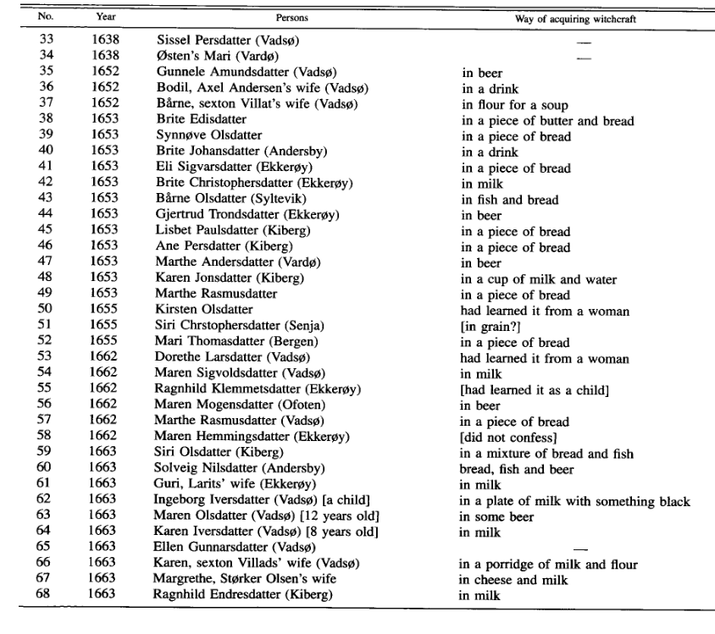
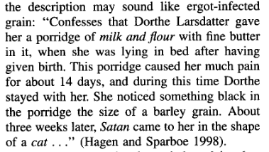
Temptation of Saint
Anthony 1512-1516
Matthias Grünewald
???
@RowenaCHill

Slide 40

What have we learnt from mythbusting?
Discoveries are rarely from individual genius
The world is complex and nuanced!
It’s easy to create narratives
Fungi are super cool!
@RowenaCHill

Slide 41
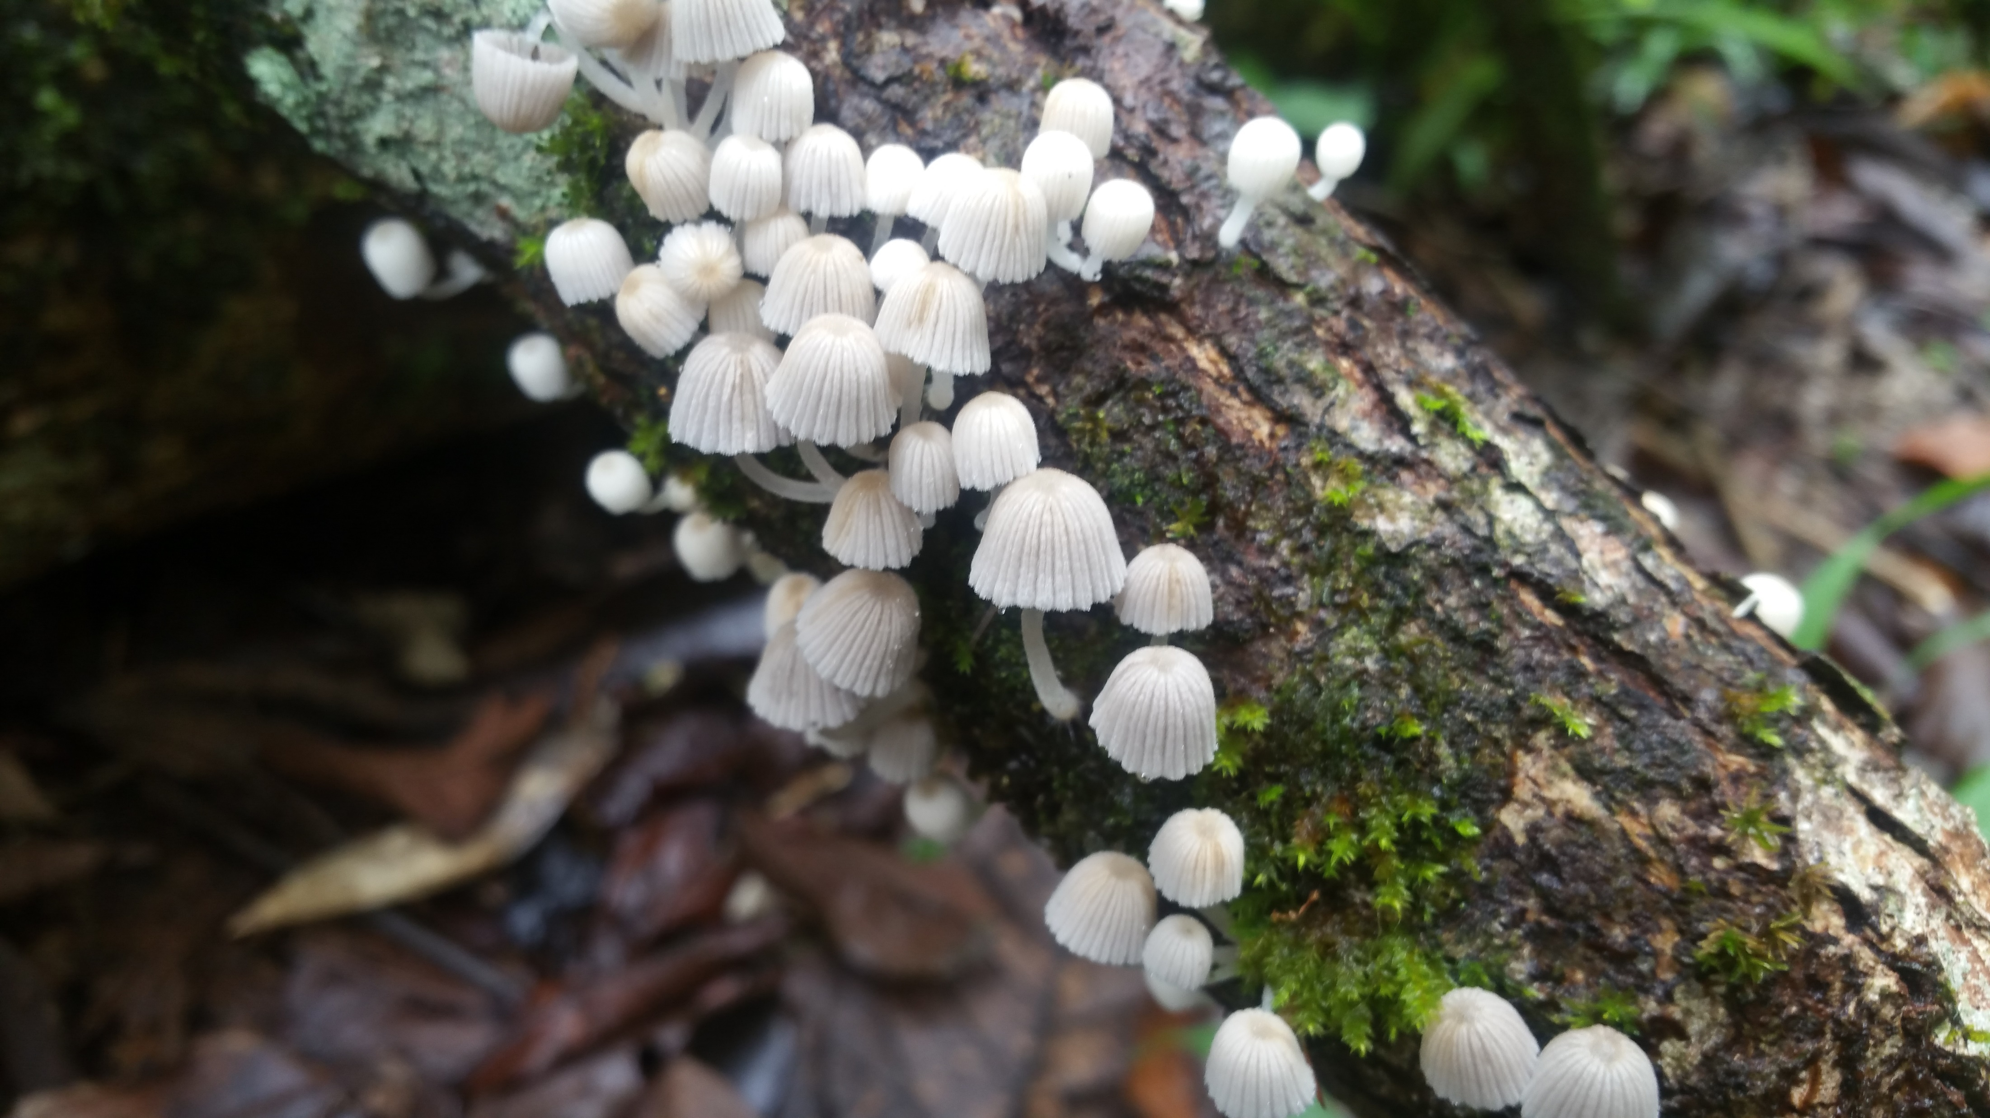

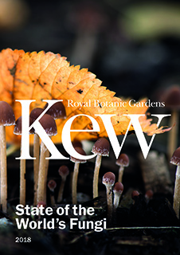


github.com/Rowena-h/Presentations
@RowenaCHill
stateoftheworldsfungi.org
Thanks for listening!
@mushroommovieee for all the superlative gifs!

